Slide 1

AgriGrow: A Technique for crop disease detection and Recommedation
Presented By -
Under the supervision of
Prerit Kumar Jain
Regd. No. 2102040011
Dr. Santi Kumari Behera
Department of Computer Science and Engineering
Veer Surendra Sai University of Technology, Burla
2024-25
1

Slide 2
OUTLINE
Introduction
Motivation
Objective
Literature Review
Work Done
Conclusion and Future Work
Reference
2

Slide 3
Introduction
Crop diseases significantly impact yields, quality, and food security.
Key crops like corn, tomatoes, and peppers are highly vulnerable to diseases (tomato leaf curl virus, pepper blight).
Traditional detection methods are time-consuming and prone to errors.
Proper use of fertilizers and the right crop to grow according to the soil conditions.
Machine learning, especially CNNs, enables automated and accurate disease detection.
Focus on creating accessible tools, such as mobile apps or websites, to empower farmers.
3

Slide 4
Motivation
Minimize crop losses and waste of resources by equipping farmers with user-friendly ML tools for crop disease identification, crop selection, and fertilizer recommendation. To make agriculture smarter and sustainable by offering one-stop-shop solutions for decision-making on crop health, compatibility, and nutrition.
4

Slide 5
Objective
The primary goal of this initiative is to develop machine learning models that can:
Accurately detect multiple diseases: Predict all diseases present in images of corn, pepper, and tomato crops.
Create Smart Crop Suggestion: Create a system to recommend appropriate crops with soil information.
Create Accurate Fertilizer Guidance: Create a utility that will provide appropriate fertilizers and amounts for specific crops and soil types.
Integrate into Simple Web App: Embed all functionality in an easy-to-use web application for farmers/users.
5

Slide 6
Literature Review
Table 1 : Previous Research Papers
Sl No. | Author | Year | Outcomes
1. | Chakraborty and Newtonet al. | 2011 | Shifting weather patterns and rising temperatures intensify disease outbreaks, prompting adaptive machine learning models to incorporate climate data for enhanced agricultural disease detection.
2. | Mohanty et al. | 2016 | Achieved 99% accuracy on test datasets using CNNs for disease detection but faced performance drops on real-world images, highlighting the need for better generalization to field conditions.
3. | Sladojevic et al. | 2016 | Improved adaptability to unseen diseases and minimized reliance on large datasets by fine-tuning pre-trained CNNs, highlighting the scalability of machine learning models for various agricultural applications.
4. | Amara et al. | 2017 | Achieved high accuracy under controlled conditions but struggled to generalize to real-world scenarios, emphasizing the need for larger and more diverse datasets to enhance model robustness.
5. | Fuentes et al. | 2018 | Successfully localized and identified disease symptoms in images, offering actionable insights for targeted interventions and demonstrating value for real-time precision agriculture applications.
6

Slide 7
Cont...
Sl No. | Author | Year | Outcomes
6. | Ramcharan et al. | 2019 | Achieved around 80% accuracy in real-world scenarios, highlighting the practicality of mobile applications as accessible diagnostic tools to empower farmers with advanced disease detection capabilities.
7. | Too et al. | 2019 | Enhanced the accuracy and robustness of CNN models for tomato disease detection, emphasizing the importance of data augmentation in improving model performance.
8. | Zhang et al. | 2020 | Improved classification accuracy and diagnostic efficiency by leveraging shared features across tasks. The study showcased the potential for detecting co-occurring diseases in complex agricultural environments.
9. | David et al. | 2021 | Developed lightweight models that delivered high accuracy with reduced computational and memory requirements, ensuring accessibility for farmers using entry-level smartphones in resource-constrained environments.
10. | Ma et al. | 2021 | Maintained high classification accuracy while minimizing model size and computational demands, advancing the practical deployment of machine learning solutions for smallholder farmers.
7

Slide 8
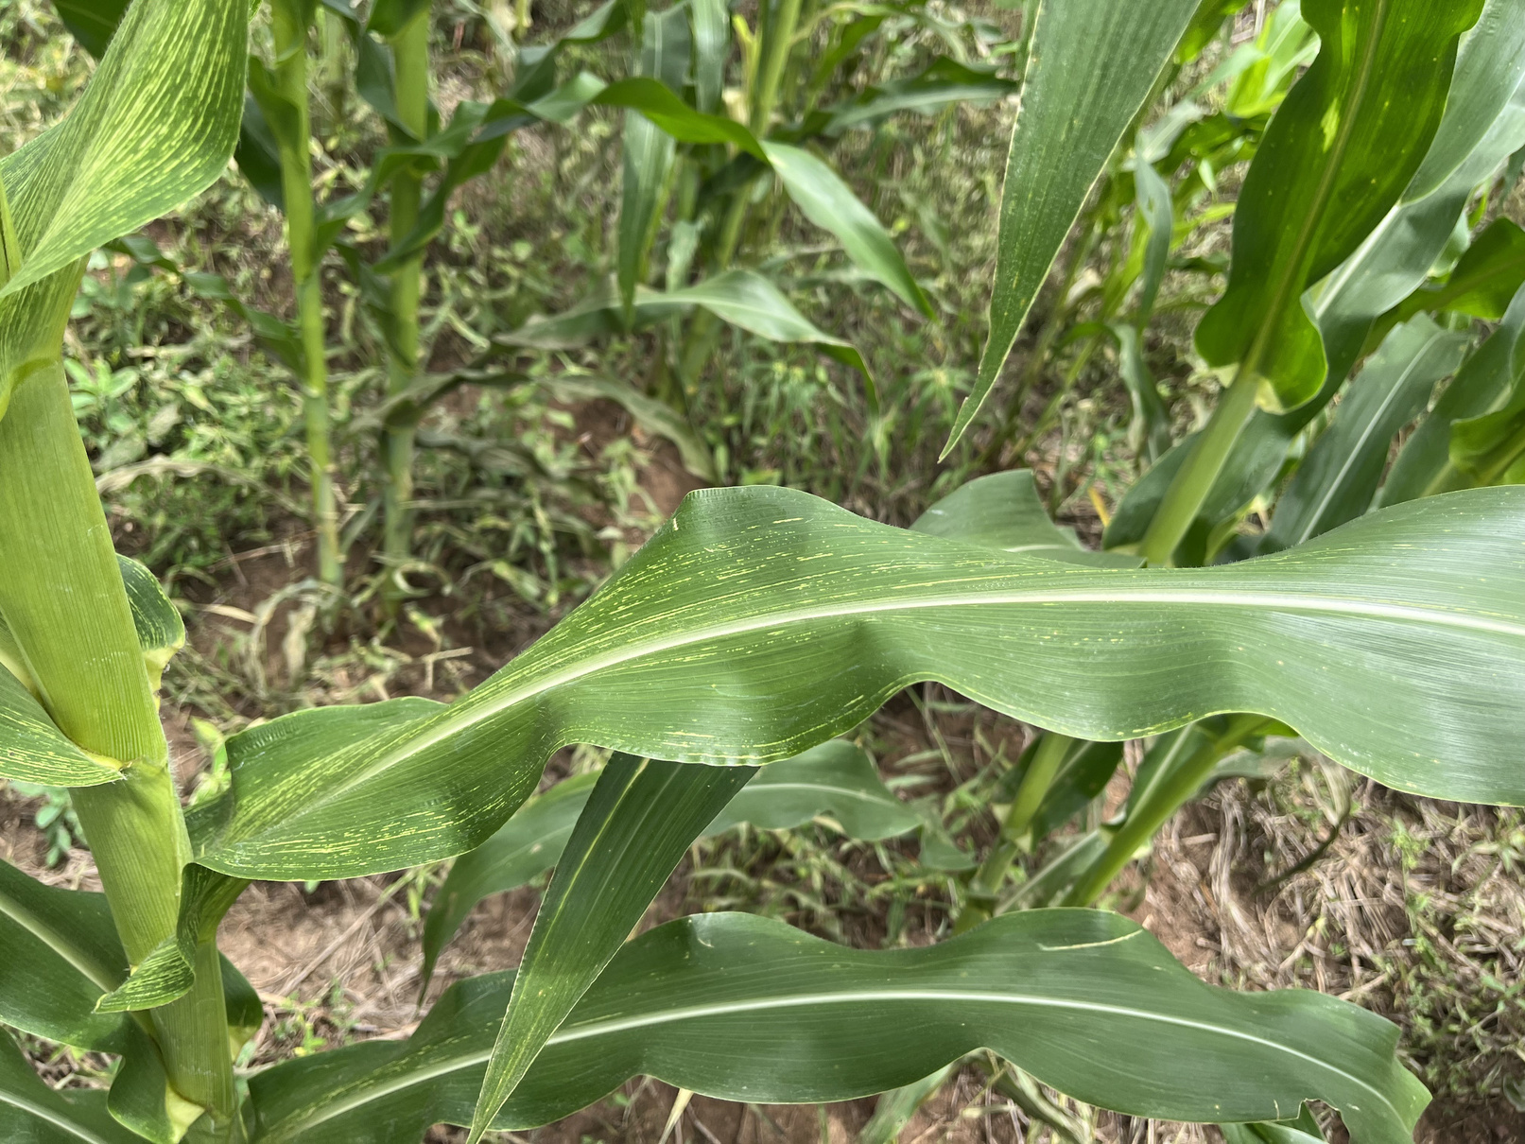
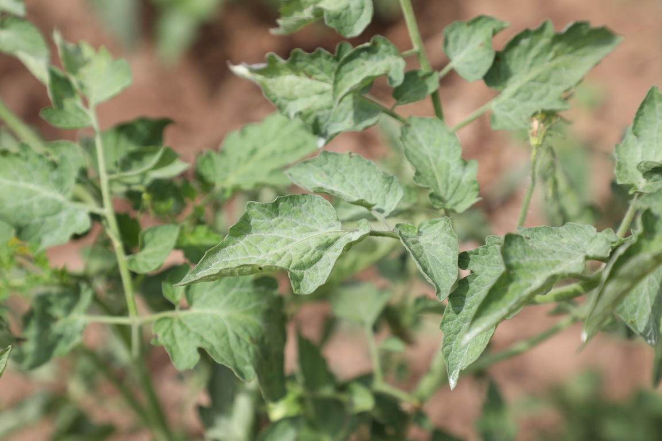
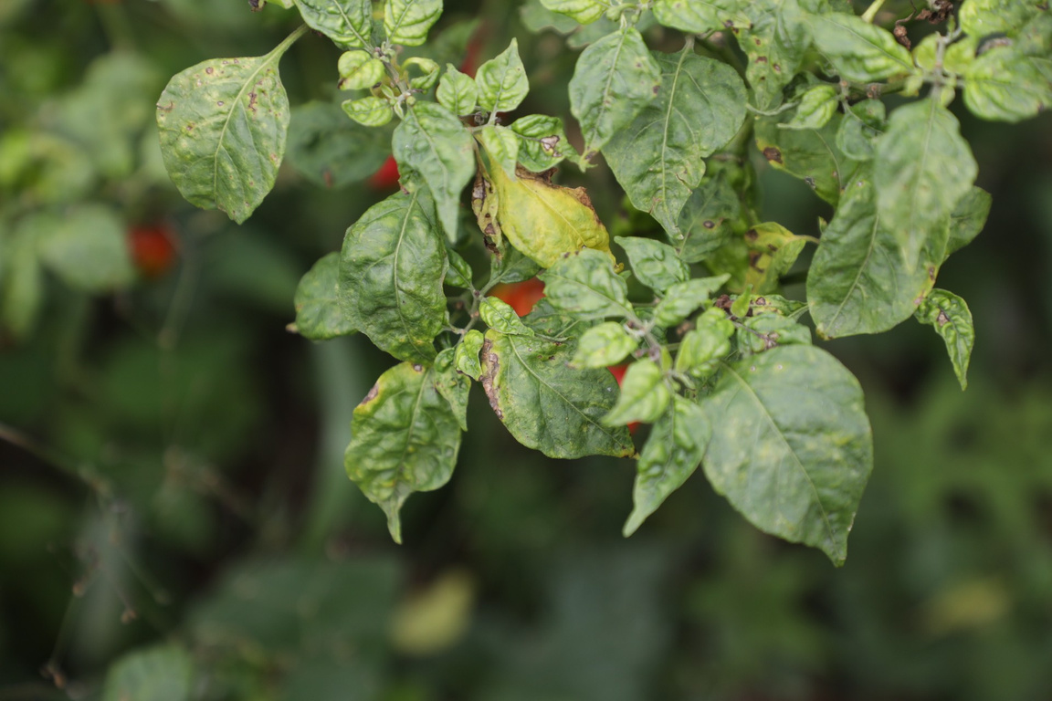
About Datasets
Corn
Tomato
Pepper
The dataset comprises thousands of high-quality images of crop leaves, captured in diverse natural settings to ensure the robustness of the machine learning models. Each image was carefully labeled by agricultural experts, indicating whether the leaf is healthy or affected by a particular disease. The dataset was picked from Kaggle, and around 70% of the data is used for training, 20% of the data is used for testing, and 10% is used for verification for crop disease detection. Around 2300 data records are used for crop and fertilizer recommendation.
8

Slide 9
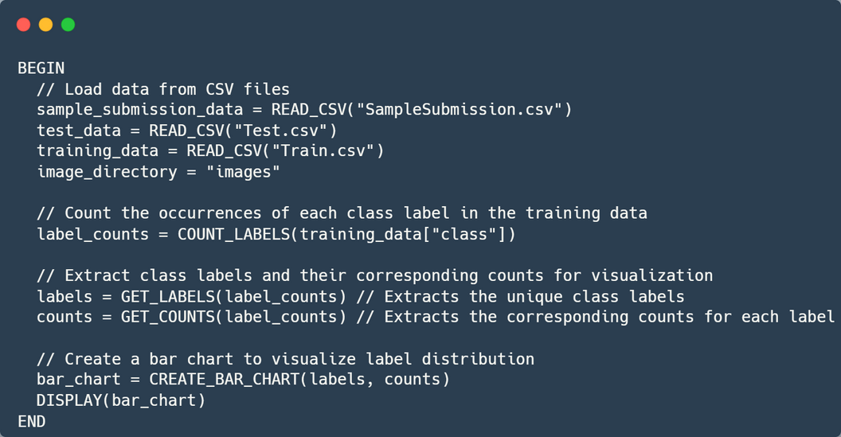
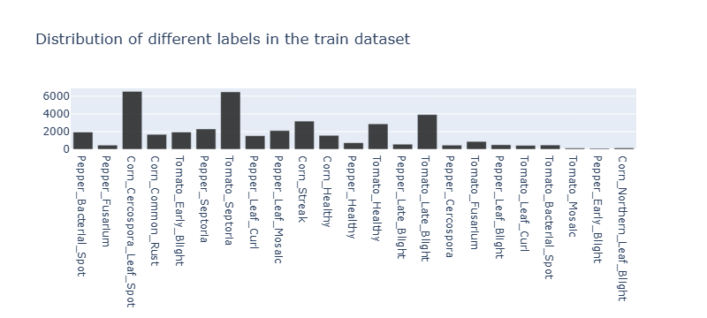
Work Done
Data Loading
Data loading and initial visualization are fundamental first steps in machine learning, transforming raw data into informative information.
Effective visualization serves as a bridge between complex data and actionable intelligence, setting the stage for robust machine learning models.
Fig. 1 Bar Chart of data classes
9

Slide 10
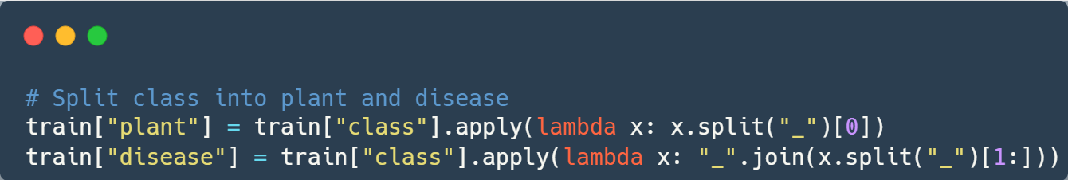
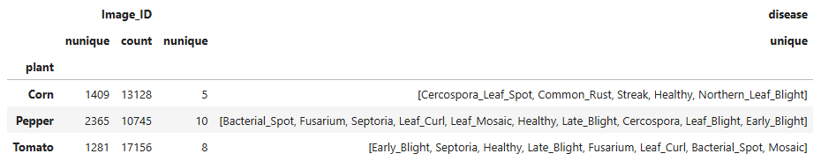
Data Preprocessing
Data preprocessing is a critical preparatory phase in machine learning that transforms raw data into a clean, consistent, and model-ready format.
It helps machine learning algorithms interpret information more accurately, reduces bias, and significantly enhances the potential for generating meaningful and reliable insights from complex datasets.
Fig. 2 Classification of data using type of plant and diseases
10

Slide 11
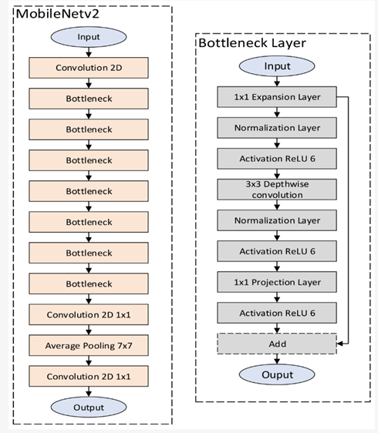
Model used for Crop Disease Prediction
MobileNetV2
MobileNetV2 was selected especially because of the embedding of its native structural strengths, its proven image classification capability, and its applicability to active environments.
Its architecture incorporates advancements in the form of depthwise separable convolutions and inverted residual blocks with linear bottlenecks.
MobileNetV2 has attained competitive accuracy on large-scale image classification benchmarks.
Fig. 3 Architecture of MobileNetV2 [5]
11

Slide 12
Reason for using MobileNetV2 Model
Computational Efficiency and Mobile friendly
Strong Performance on Large-Scale Image Classification
Ideal Balance Between Model Size and Predictive Accuracy
Ease of Implementation within Standard Frameworks and Availability of Pre-trained Weights
Increased Performance and Accuracy with fine-tuning
12

Slide 13
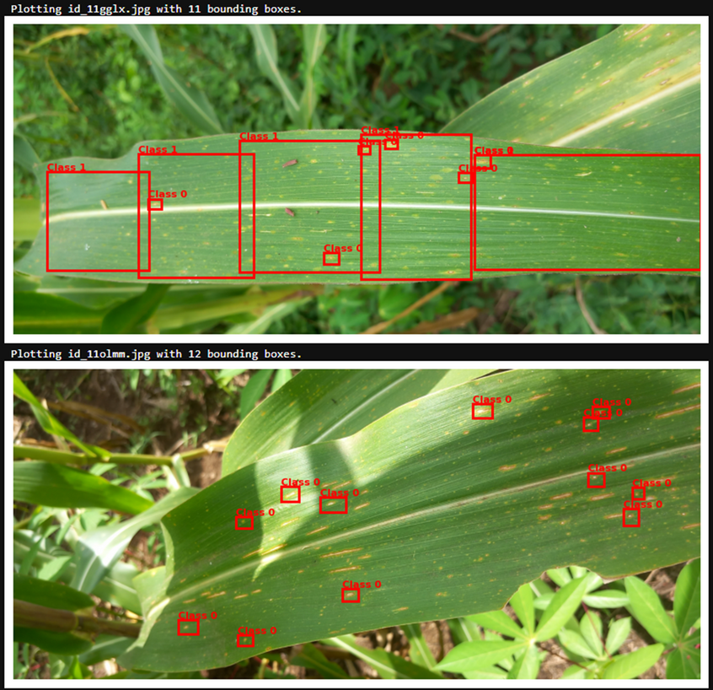
Bounding Box Visualization
Bounding box visualization is a fundamental technique in computer vision and object detection that graphically represents the location and extent of detected objects within an image.
By drawing rectangular frames around identified objects, this method provides a clear, intuitive way to illustrate machine learning model predictions, helping researchers and developers verify the accuracy of object detection algorithms.
Fig. 4 Bounding Boxes Visualization
13

Slide 14
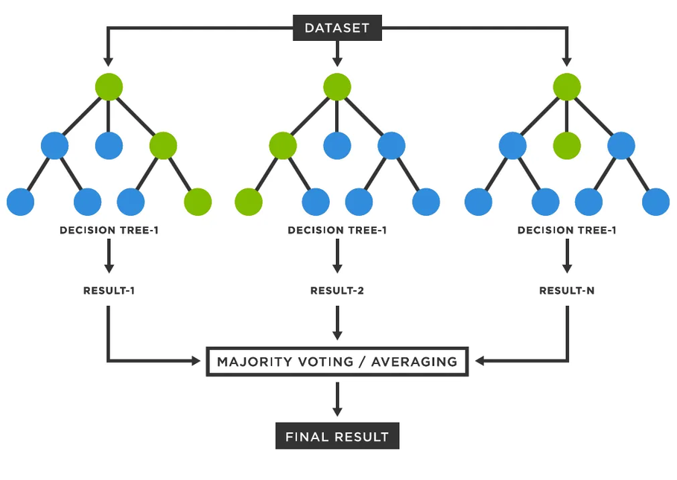
Model used for Crop and Fertilizer Recommendation
For the intelligent crop recommendation module of this agricultural decision support system, a Random Forest algorithm was applied.
Random Forest works by creating an enormously large number of decision trees while training and predicting the class that is the mode of the classes (classification) or average prediction (regression) of the trees.
In our scenario, it is applied to classification – to anticipate the best crop from a list given.
Fig. 5 Architecture of Random Forest Classifier [9]
14

Slide 15
Random Forest Working Process:
Bootstrap Sampling
Bootstrap Sampling (Bagging): Random Forest constructs many decision trees. Each tree, it takes a random sample of training data with replacement (bootstrapping).
Random Feature Selection: In every node of a decision tree, while selecting the optimal split, Random Forest selects a random subset of features and selects the best split from that subset alone. The number of features to look at per split is a hyperparameter.
Growing Multiple Decision Trees: Steps 1 and 2 are iterated in order to grow a large number of different decision trees (the "forest"). Each tree is grown to full depth without pruning.
Aggregation for Prediction: When a new data point (e.g., soil N, P, K, temperature, and rainfall values) must be classified, it is propagated down each tree in the forest. Each tree "votes" for a class.
Random Feature Selection
Growing Multiple Decision Trees
Aggregation and Predicition
Fig. 6 Working of Random Forest Classifier
15

Slide 16
Reason for using Random Forest
High Accuracy and Robustness
Handles Non-Linear Relationships Well
Handling High-Dimensional Data
Good Performance with Default Hyperparameters
Effective for Training and Prediction (for comparatively smaller-sized datasets)
Good for Categorical and Numerical Data
16

Slide 17
Web Application
17

Slide 18
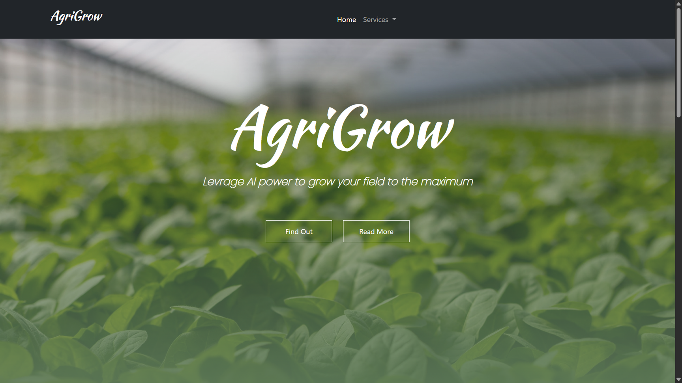
Landing Page
18

Slide 19
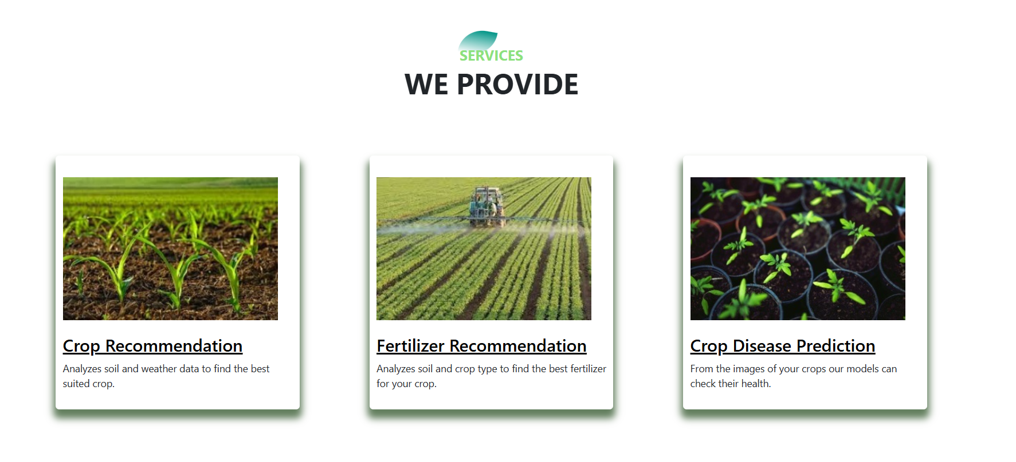
Services Provided
19

Slide 20
Work flow for the Web Application
User accesses the web application
User chooses an option
Upload crop image for disease prediction
Upload crop image for disease prediction
Upload crop image for disease prediction
The system processes the request using trained models
The result is displayed on the frontend
20

Slide 21
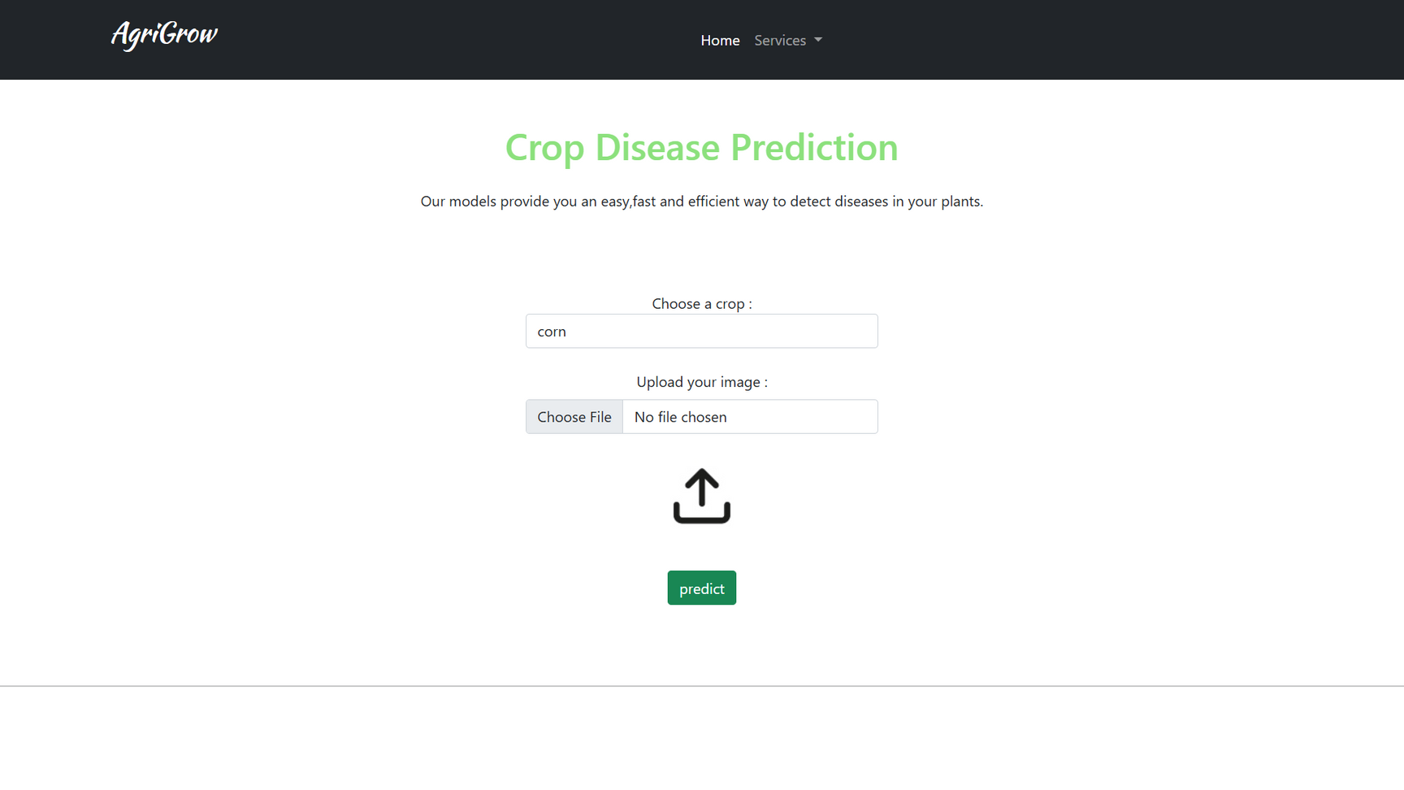
Front End of Crop Disease Prediction
21

Slide 22
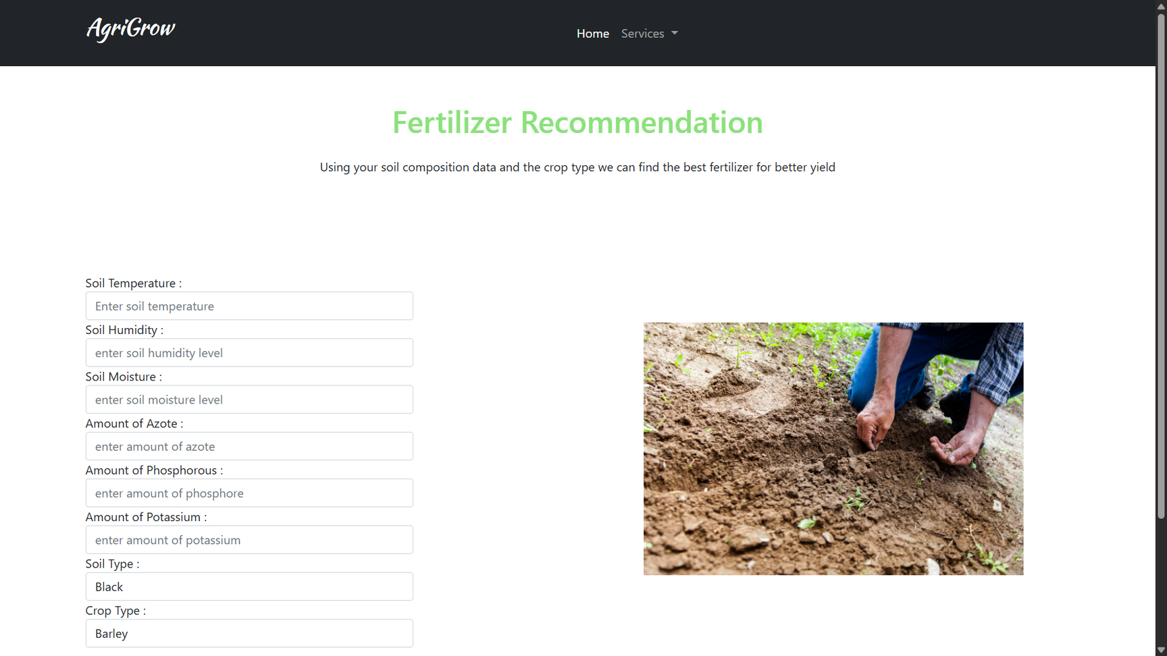
Front End of Fertilizer Recommendation
22

Slide 23
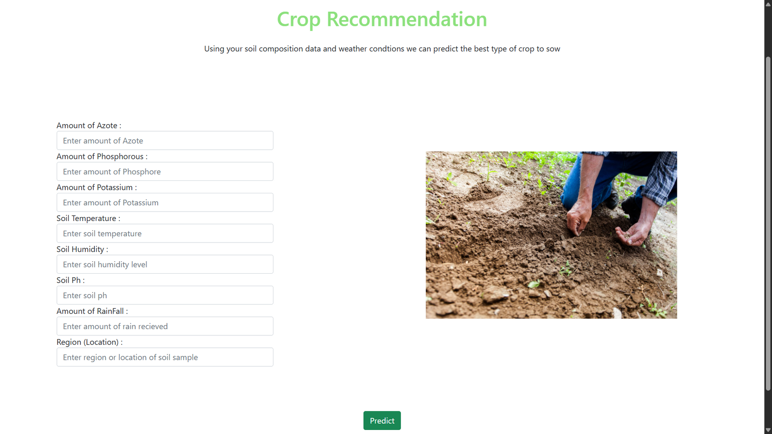
Front End of Crop Recommendation
23

Slide 24
Result and Conclusion
The model's performance, when cross-validated against a particular test set, yielded a typical accuracy of 91% and an F1-score, precision and recall of 0.901, 0.913 and 0.90, respectively
The system pushes the farmer towards efficient plantation choice and thereby provides a high possibility for lush harvesting.
The optimal type of fertilizer and amount to apply, with the aim of achieving maximum plant nutrition at the lowest economic and environmental cost
Future Scope
Sets More Crops and illnesses
User Feedback Mechanisms
Soil Sensor Integration
24

Slide 25
References
[1] Chakraborty, S., & Newton, A. C. (2011). Climate change, plant diseases, and food security: An overview. Plant Pathology, 60(1), 2-14. https://doi.org/10.1111/j.1365-3059.2010.02411.x
[2] Fuentes, A., Yoon, S., Kim, S. C., & Park, D. S. (2018). A robust deep-learning-based detector for real-time tomato plant diseases and pests recognition. Sensors, 18(12), 4133. https://doi.org/10.3390/s18124133
[3] Mohanty, S. P., Hughes, D. P., & Salathé, M. (2016). Using deep learning for image-based plant disease detection. Frontiers in Plant Science, 7, 1419. https://doi.org/10.3389/fpls.2016.01419
[4] Ramcharan, A., Baranowski, K., McCloskey, P., Ahmed, B., Legg, J., & Hughes, D. P. (2019). A mobile-based deep learning model for cassava disease diagnosis. Frontiers in Plant Science, 10, 272. https://doi.org/10.3389/fpls.2019.00272
[5] Sladojevic, S., Arsenovic, M., Anderla, A., Culibrk, D., & Stefanovic, D. (2016). Deep neural networks-based recognition of plant diseases by leaf image classification. Computational Intelligence and Neuroscience, 2016, 3289801. https://doi.org/10.1155/2016/3289801
25

Slide 26
Cont...
[6] Too, E. C., Yujian, L., Njuki, S., & Yingchun, L. (2019). A comparative study of fine-tuning deep learning models for plant disease identification. Computers and Electronics in Agriculture, 161, 272-279. https://doi.org/10.1016/j.compag.2018.03.032
[7] Zhang, S., Huang, W., & Zhang, C. (2020). Plant disease recognition based on image processing and deep learning. Computers and Electronics in Agriculture, 165, 104943. https://doi.org/10.1016/j.compag.2019.104943
[8] David, K., & Misra, B. B. (2021). Optimizing deep learning models for on-device plant disease detection. AI in Agriculture, 1(1), 35-45. https://doi.org/10.1016/j.aiag.2021.07.001
[9] Ma, J., Du, K., Zhang, L., Zheng, F., Chu, J., & Sun, Z. (2021). A lightweight convolutional neural network for on-device plant disease diagnosis. Computers and Electronics in Agriculture, 180, 105855. https://doi.org/10.1016/j.compag.2020.105855
[10] Amara, J., Bouaziz, B., & Algergawy, A. (2017). A deep learning-based approach for banana leaf disease classification. Proceedings of the IEEE Conference on Computer Vision and Pattern Recognition (CVPR) Workshops, 2017, 1-5.
26

Slide 27
Thank You!!
27

